Slide 1
Strategy Maps
Homework # 02
File Name:
110368151_呂彥旻_02_SM_Transform Conventional Industry.pptx
Due Time: 2022.04.07, Thursday, 23:59:59

Slide 2
21st Century
VUCA
Era
Volatile
Complex
Uncertain
Selecting just one topic will suffice for Homework # 02.
Woodworking
Industry
(>=5 Slides)
Soap
Industry
(>=5 Slides)
Ceramics
Industry
(>=5 Slides)
Toothpaste
Industry
(>=5 Slides)
Strategies To Transform & Upgraded
Taiwan’s
Conventional
Industries
Glass
Industry
(>=5 Slides)
T
Industry
(>=5 Slides)
Baking
Industry
(>=5 Slides)
Sneakers
Industry
(>=5 Slides)
Cake
Industry
(>=5 Slides)
Shoes
Industry
(>=5 Slides)

Slide 3
21st Century
VUCA
Era
Volatile
Complex
Uncertain
Ambiguous
Ask
Reasons Why
All the Time
(Step 0)
Solution(s)
Proposing
(Step 4)
Problem
Identification
(Step 1)
How to
Perform
Research
???
Cause(s)
Finding
(Step 3)
Analysis
Performing
(Step 2)

Slide 4
International Websites of My Interest
www.washingtonpost.com
www.nytimes.com
www.voanews.com
www.cnn.com
www.latimes.com
www.apnew.com
www.upi.com
www.usatoday.com
www.independent.co.uk
www.theguardian.co.uk
www.dailymail.co.uk
www.mirror.co.uk
www.thesun.co.uk
www.thetimes.co.uk
www.ft.co.uk
www.abc.net.au
www.atimes.com
www.straitstimes.com
www.japantimes.co.jp
www.siberiantimes.com
www.mexicodailynews.com
www.wikipedia.org
www.wikihow.com
www.airweb.org
www.youtube.com

Slide 5
International Websites of My Interest
www.un.org
europa.eu
www.whitehouse.gov
www.state.gov
www.defense.gov
www.senate.gov
www.foreign.senate.gov
www.congress.gov
foreignaffairs.house.gov
www.loc.gov
www.gpo.gov
www.hsdl.org
fas.org
ssi.armywarcollege.edu
usnwc.edu
www.warhistoryonline.com
warontherocks.com
www.navy.mil
www.cpf.navy.mil
seabeemagazine.navylive.dodlive.mil
www.dtic.mil/dtic/search/tr/tr.html
www.armscontrol.org
www.globalfirepower.com

Slide 6
International Websites of My Interest
www.ncafp.org
www.csis.org
www.rand.org
www.hudson.org
www.wilsoncenter.org
www.defenddemocracy.org
www.pewglobal.org
www.pewresearch.org
www.heritage.org
www.brookings.edu
carnegieendowment.org
c4ads.org
thehill.com
www.nationalinterest.com
www.foreignpolicy.com
www.foreignaffairs.com
www.defensenews.com
www.thediplomat.com
www.bloomberg.com
www.stripes.com
www.aspi.org.au
www.lowyinstitute.org
spfusa.org
www.mod.go.jp
www.css.ethz.ch
www.wikileaks.org

Slide 7
Taiwan’s Websites of My Interest
www.president.gov.tw
www.mofa.gov.tw
www.stat.gov.tw
www.globaltaiwan.org
focustaiwan.tw
www.taiwandocuments.org
fapa.org
www.us-taiwan.org
www.ustaiwandefense.com
www.taiwannews.com.tw
www.taipeitimes.com
englishnews.ftv.com.tw
chinapost.nownews.com
www.icrt.com.tw

Slide 8
China’s Websites of My Interest
www.gov.uk/government/collections/six-monthly-reports-on-hong-kong
english.boaoforum.org
www.aiib.org
www.focac.org/eng
english.hanban.org
www.scmp.com
en.people.cn
www.globaltimes.com.cn
www.fmprc.gov.cn/mfa_eng
english.cctv.com
www.chinadaily.com.cn
usa.chinadaily.com.cn
english.chinamil.com.cn
kcnawatch.co

Slide 9
How about
Website of Your Interest?
God Google:
www.google.com

Slide 10
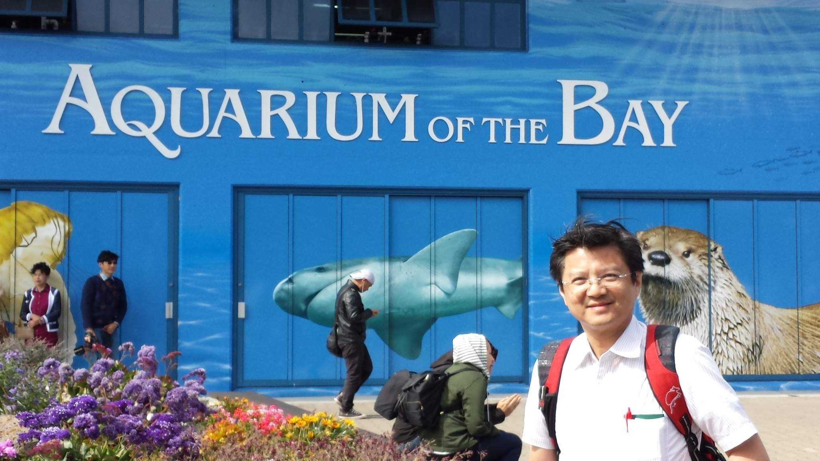
Taipei Tech – Prof. Cheng-Chieh Yu - CV
San Francisco, California, USA, June 3, 2015
9

